Slide 1
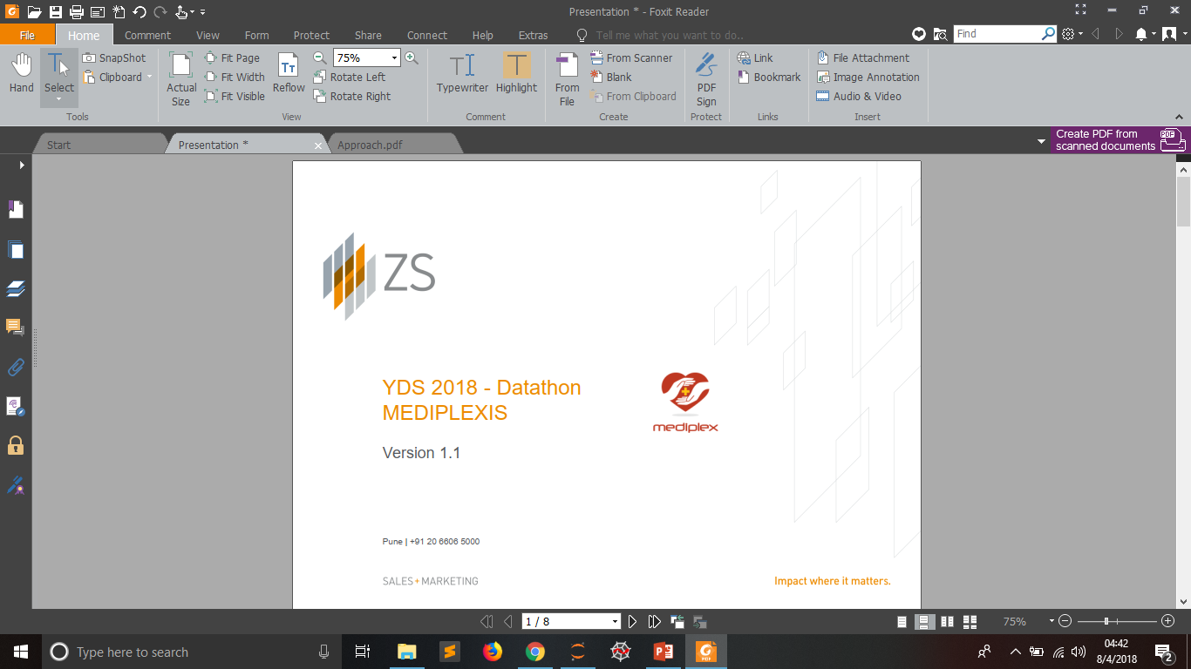
ZS YDS DATATHON-2018
Mediplex case study

Slide 2
AGENDA
ZS has sampled data from Mediplexis corporation which includes affinity data through historical channel interactions with various doctors.
Every Channel has different affinity rating for different doctors.
But in the dataset provided to us we have few null values to fill.
So as data science practioner we need to solve this challenge using Machine Learning.

Slide 3
Pipeline Used For The Given Problem:
Import Python Library
Load The Dataset
Apply Pre-Eliminary Data Analysis
Observe Key Trends
Construct New Features (If Possible)
Try Different ML Algorithms
Optimized The Model Using Validation Set and Given Evaluation Metric
Take The Model Which Gives Best Result

Slide 4
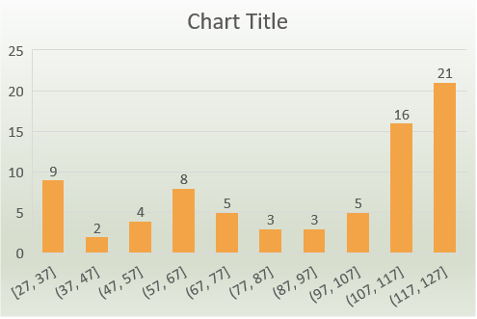
Quality Checks Performed / Error Found:
I have found that we have doctors with much higher age than the median age of population.
I thought of this as an anomaly.

Slide 5
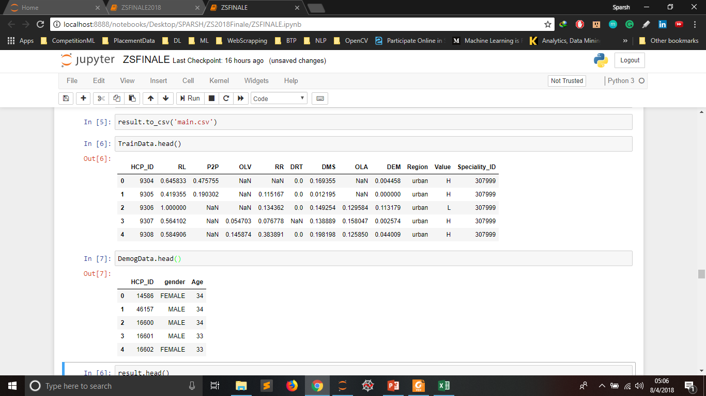
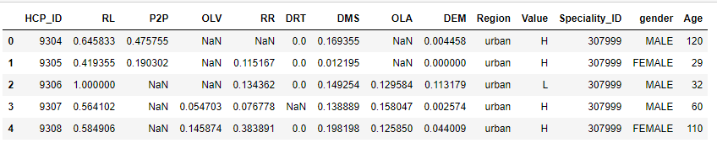
Data Preprocessing Steps:
Merged(Left Join) the Train and Demog Data on the basis of HCP_ID Column Values

Slide 6
Data Preprocessing Steps:
I found that when merging the train data and demog data there were 28 missing values in the age column.
So I have filled those null values with mode of the age population i.e. MALE.

Slide 7
Data Preprocessing Steps:
I have used Label Encoding technique in order to deal with categorical features like:
Region – 2 Types of Values
Value – 4 Types of Values
Speciality_ID – 16 Types of Values
Gender – 2 Types of Values

Slide 8
Key Observation and Trends:

Slide 9
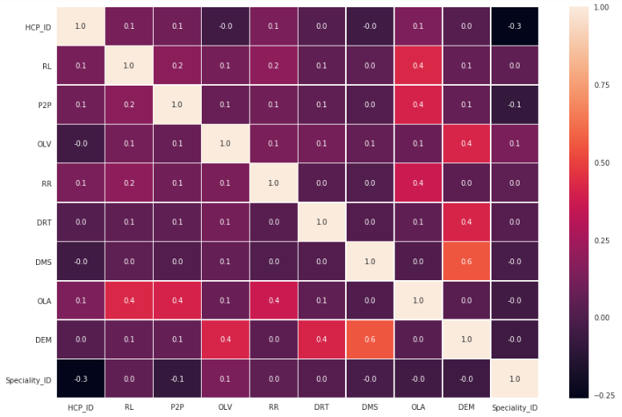
Key Observation and Trends:
Heatmap show that there is a little bit correlation between variables but its not up to the mark.

Slide 10
Key Observation and Trends:

Slide 11
Key Observation and Trends:
This distribution shows that more doctors are from Urban region than Rural region.

Slide 12
Key Observation and Trends:

Slide 13
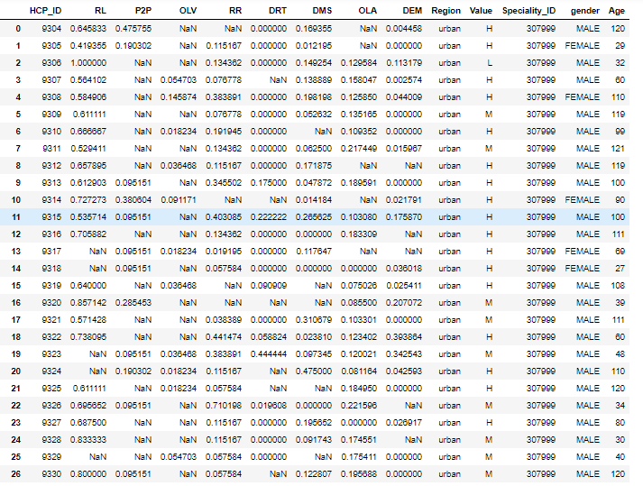
Key Observation and Trends:
There is a pattern

Slide 14
Key Observation and Trends:
No rows with all null columns are found.
There are extra 9299 HCP_ID which were present in Demog data and not in Train Data.
Number of unique values : 147 in P2P, 6245 in DMS, 37186 in HCP_ID, 792 in DRT, 700 in RR, 19381 in DEM, RL in 1589, OLA in 25310, OLV in 392.

Slide 15
Model Choice Explanation:
Used 2 different Machine Learning Algorithms :
KNN – K Nearest Neighbour
CatBoost
Used KNN Imputer to fill the values in the 5 columns – DEM, RR, RL, DRT, DMS
Then applied CatBoost algorithm to predict the NULL values in the 3 columns – P2P, OLV, OLA
I used to CatBoost because I have observed 4 categorical features that are – Region, Value, Speciality_ID, gender.
CatBoost works very well we have categorical features so I thought using it.

Slide 16
Other Model Choices:
We can use other models like ensemble of random forest with extra tree regressor.
we can also use models like XgBoost to solve the problem.
I have used catboost in my final submission because it was giving decent score, when I was computing it using the RMSE metric.

Slide 17
Thank You

